Slide 1
Chapter 10 – Feedback Linearization
Big Picture:
Nonlinear System
Linear System
Control Input
Transformation
When does such a transformation exist?
How do we find it?
(not really control design at this point)
Linear
Controller

Slide 2
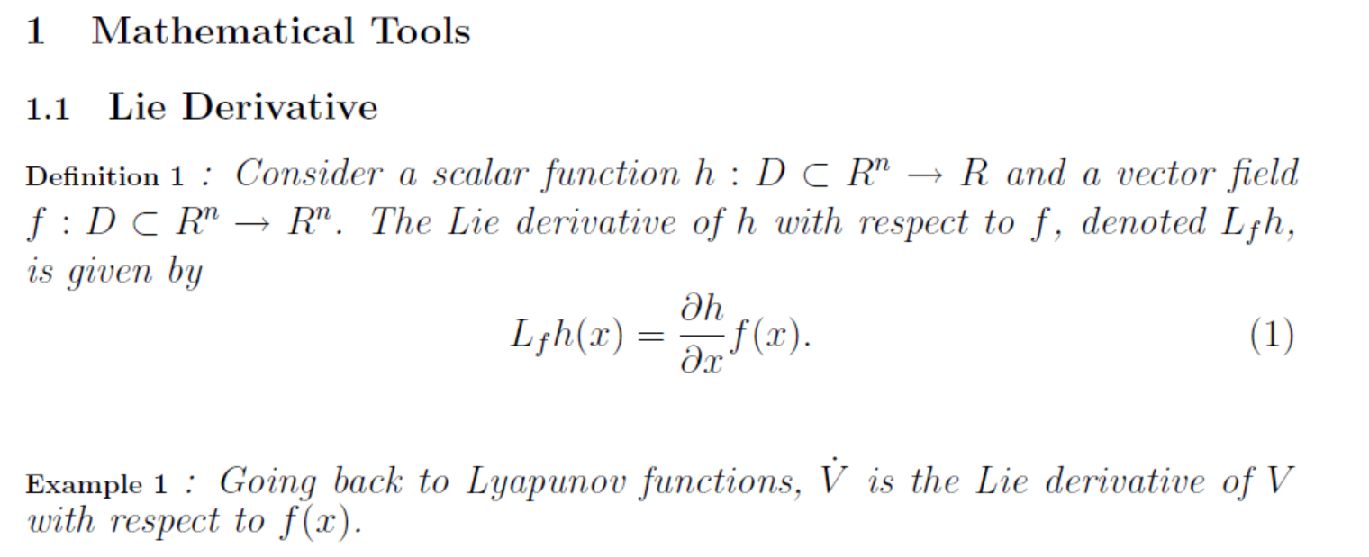

Slide 5
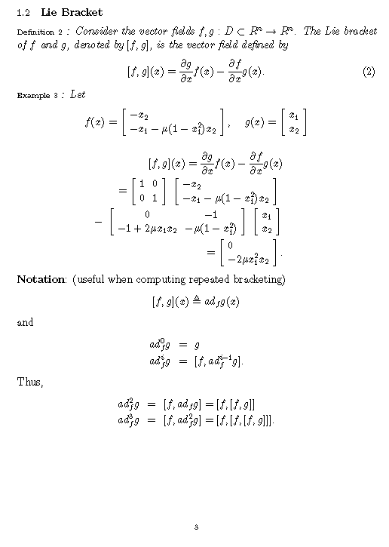
Other than here, square brackets still indicate a matrix

Slide 7
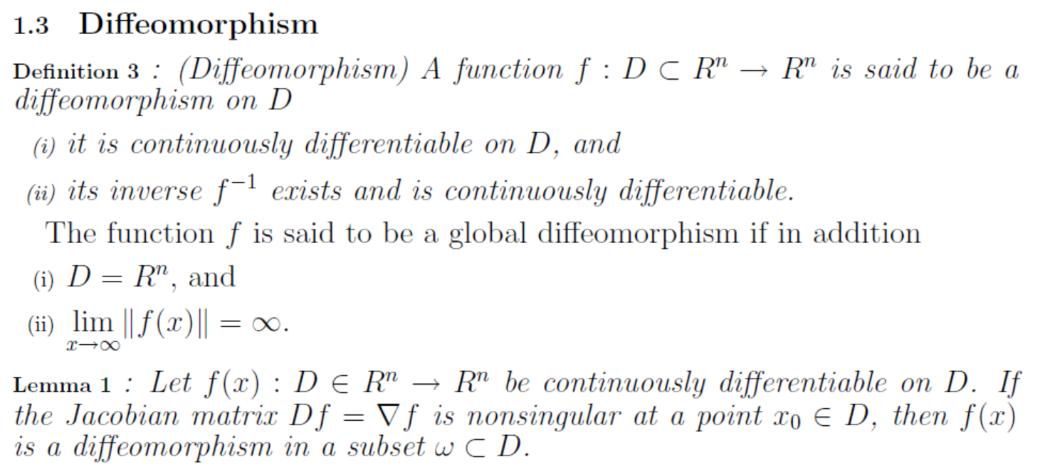

Slide 11
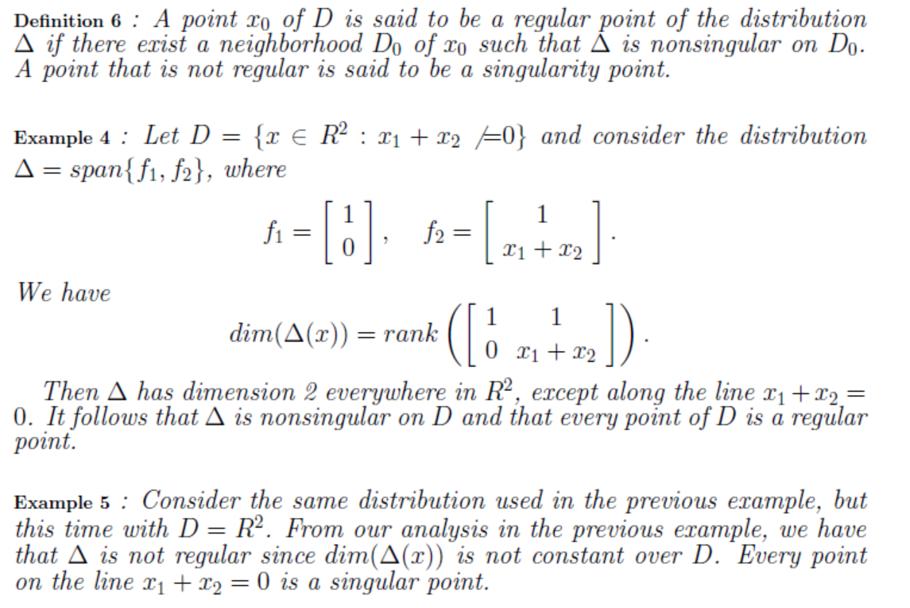
Notes:
Zai (or sai)

Slide 12
Matrix
Vectors
Lie Brackets

Slide 13
Lie Bracket
=

Slide 14
(continued)
Only [f₁,f₂] here

Slide 15
Reminder from Chapter 3.10.1 – Linear approximation of a system
System
Looks like a linear system
Taylor series at origin
Control Law
System
This is not what we will do in this section!

Slide 16
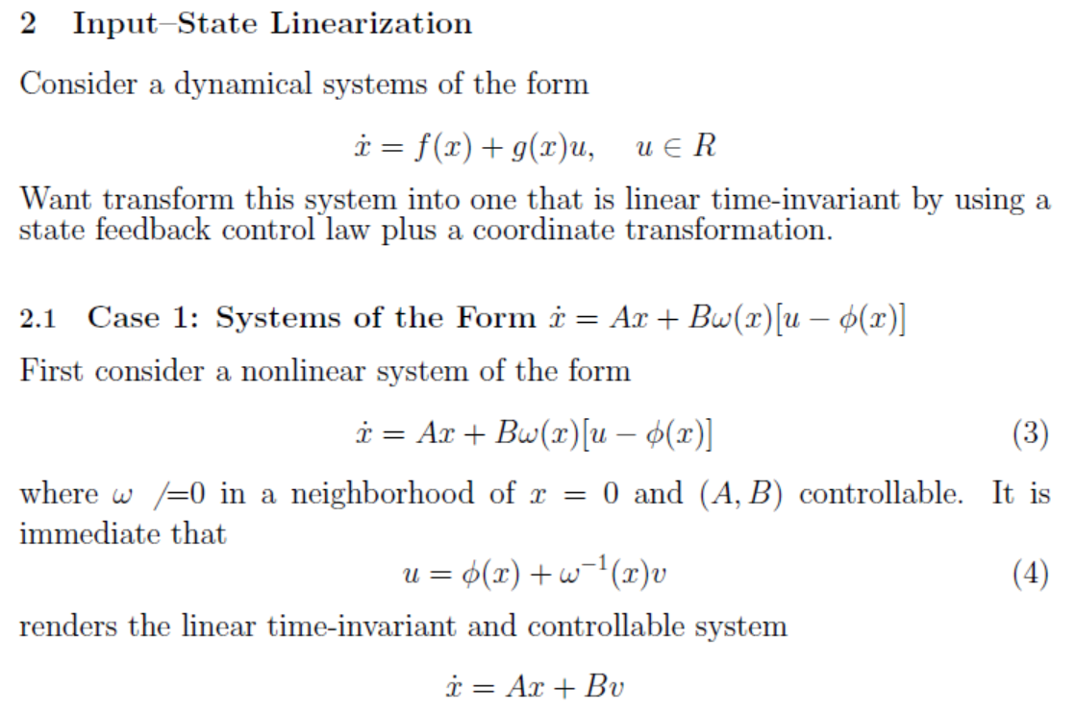
Transformation Complete: Transformed the nonlinear system into system that is linear from the input perspective.
Control Design: Use linear control design techniques to design v.

Slide 17
A
A
B is 2x1, “directs u to a specific row”
Scalar
1
Transformation Complete: Transformed the nonlinear system into a linear system.
Control Design: Use linear control design techniques to design v:
1

Slide 18
Example 7: Implementing the Result
Looks like a linear system
Control Law
Linearizing Control
System

Slide 19
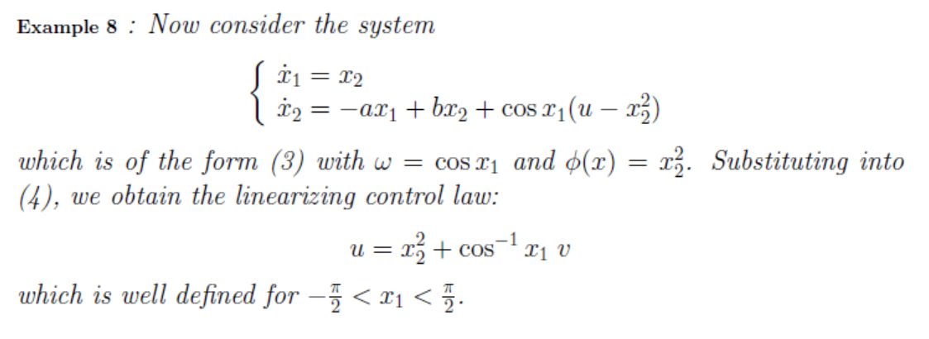
A
Transformation Complete: Transformed the nonlinear system into a linear system.
Control Design: Use linear control design techniques to design v.

Slide 20
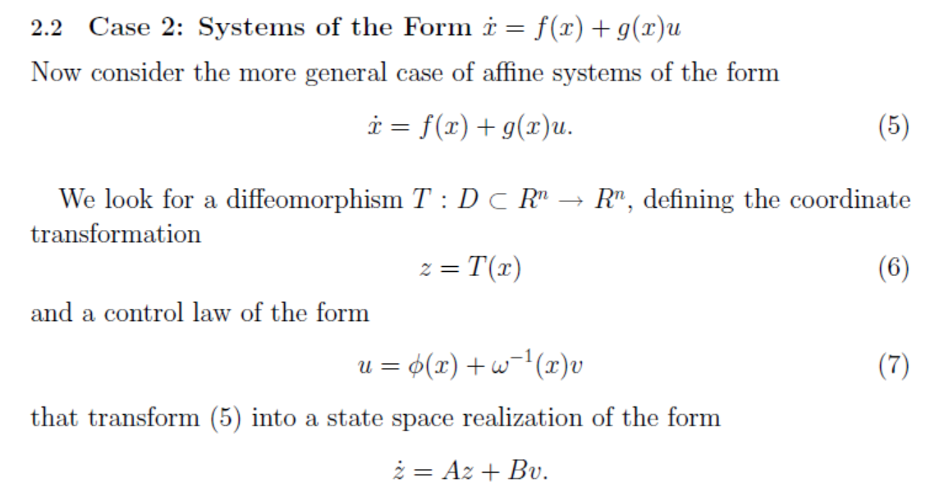
Affine in u
We are restricted to this type of system

Slide 21
Feedback linearization and transformation process:
T(x)
u(x)
v(z)
Using standard linear control design techniques
Stable closed-loop system

Slide 22
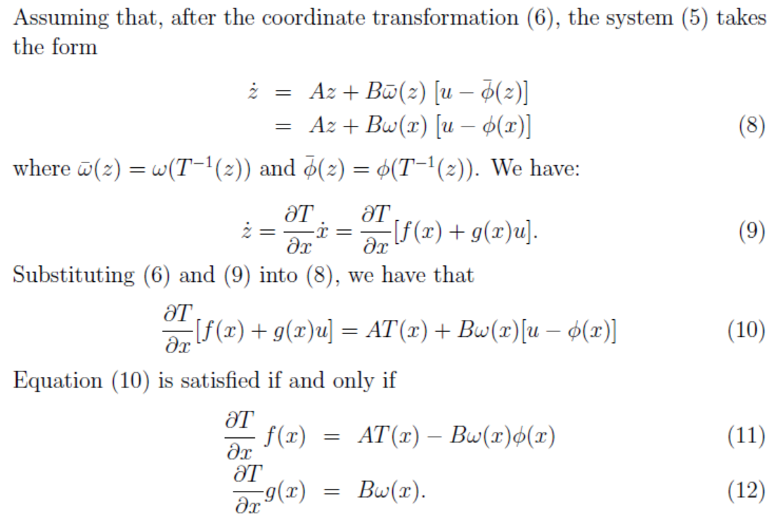

Slide 23
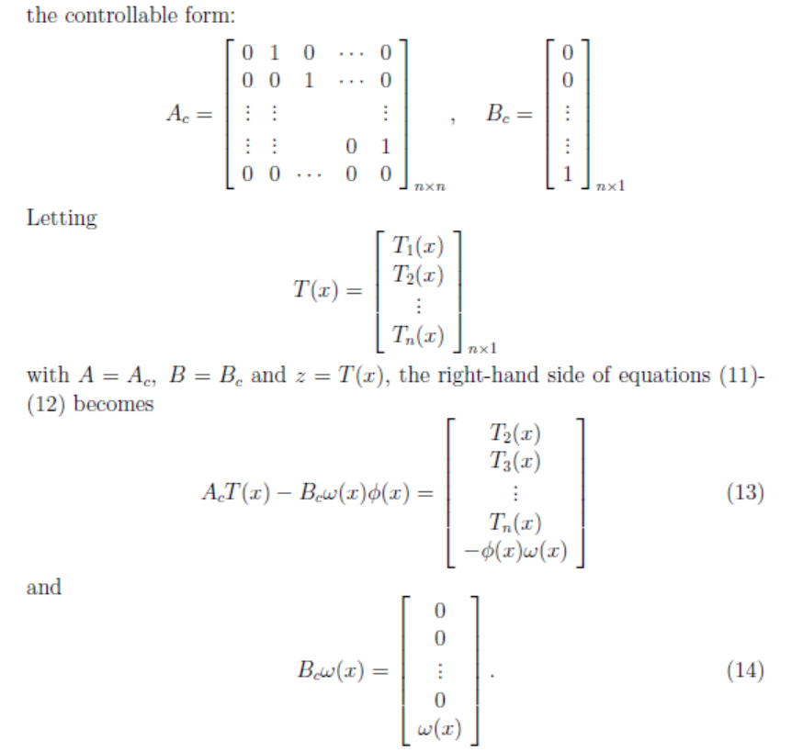

Slide 26
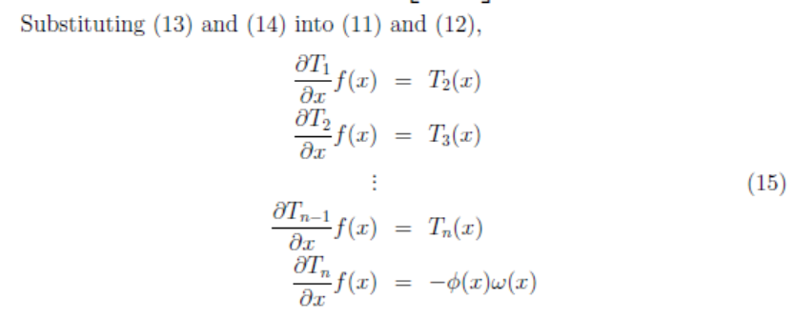
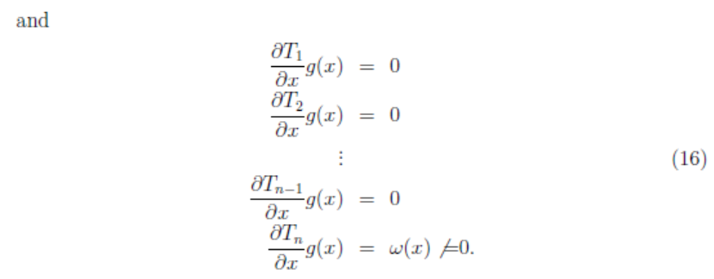

Slide 27
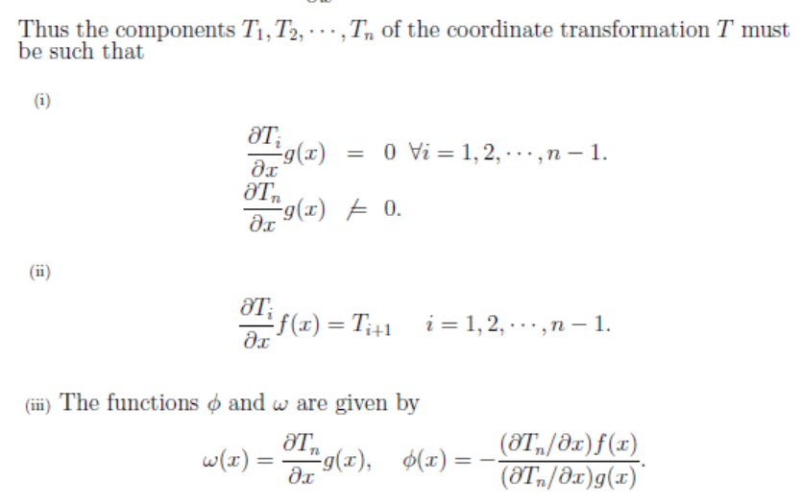

Slide 28
Not matched to u
Matched to u
Note that n=2 in the above procedure.

Slide 29
(continued)
1

Slide 30
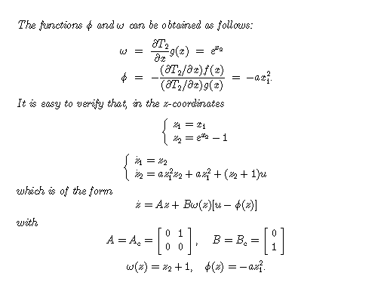
(continued)
Will only depend on T₂
Moved the nonlinearities to the bottom equation where they are matched with u

Slide 31
(continued)

Slide 32
Example 9: Implementing the Result
Looks like a linear system
Control Law
Linearizing Control
System

Slide 33
Always good to try this approach but may not be able to find a suitable transformation.
Conditions on the determinant
u “lives” behind g, so g must possess certain properties so that u has “enough access” to the system
Questions:
What is ad_{f} g(x)? Review Lie Bracket
What is a span? set of vectors that is the set of all linear combinations of the elements of that set.
What is a distribution? Review Distributions sections
What is an involutive distribution?
Lie Brackets
Matrix

Slide 34
=
n=2 (size of x)

Slide 36
System

Slide 37
Looks like a linear system
Control Law
Linearizing Control
System
System

Slide 43
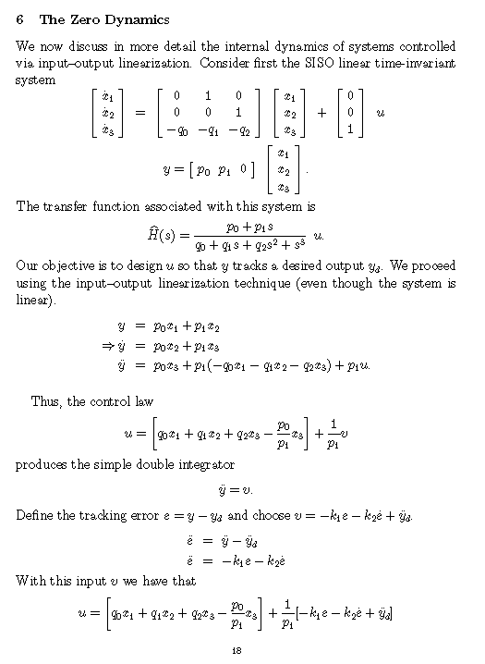

Slide 45
u
System
y
?

Slide 47
.

Slide 48
=

Slide 49
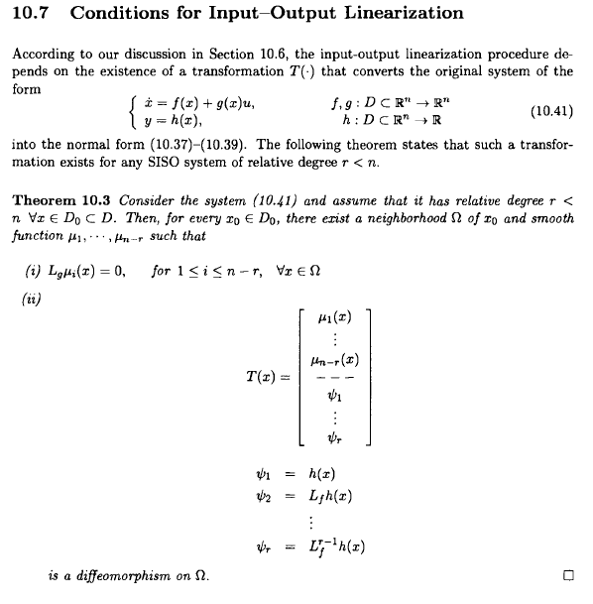

Slide 50
Supplemental Notes on Linearization
Reminder from Chapter 3.10.1 – Linear approximation of a system
System
Looks like a linear system
Taylor series at origin
Control Law
System

Slide 51
Supplemental Notes on Linearization

Slide 52
Supplemental Notes on Linearization
so you need “n” values for the equilibrium point.

Slide 53
Linearization: Example

Slide 54
Linearization : Example (Contd.)

Slide 55
Linearization : Example (Contd.)

Slide 56
Linearization : Example (Contd.)

Slide 57
Summary
Linear
Controller
Main Idea
Taylor Series
Approximation
Linear
System
Nonlinear System
Linear
System
Control Input
Transformation
Linear
Controller
Input to state linearization
Input to output linearization

Slide 58
Homework 10.1

Slide 59
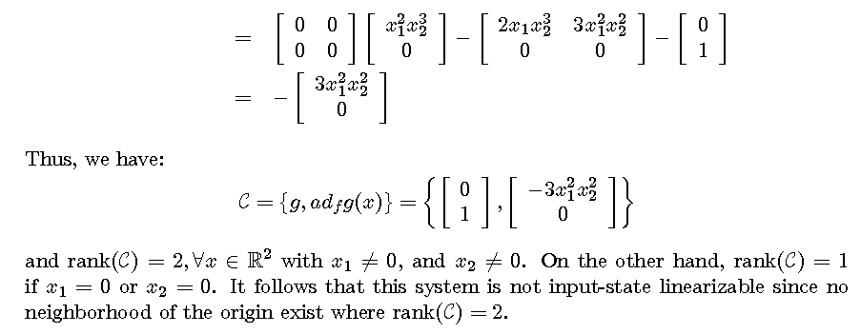

Slide 61
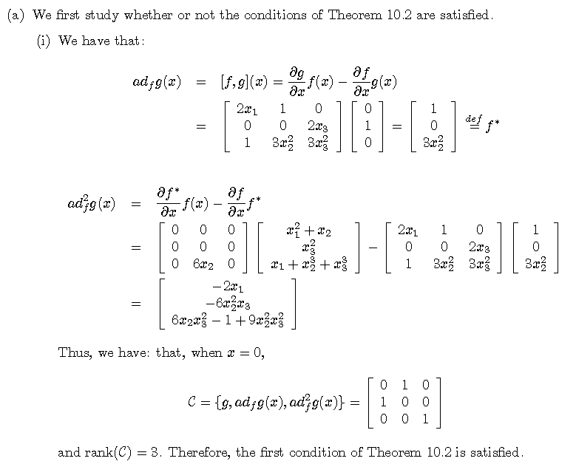
-
-
-
-
-
-
+
+
-
+
-

Slide 62
-
is only satisfied at the origin, for any x₂ not equal to 0 the rank is increased to 3. Since there is no neighborhood about the origin for which the second theorem is satisfied the system is Not input-state linearizable.
Not possible

Slide 64
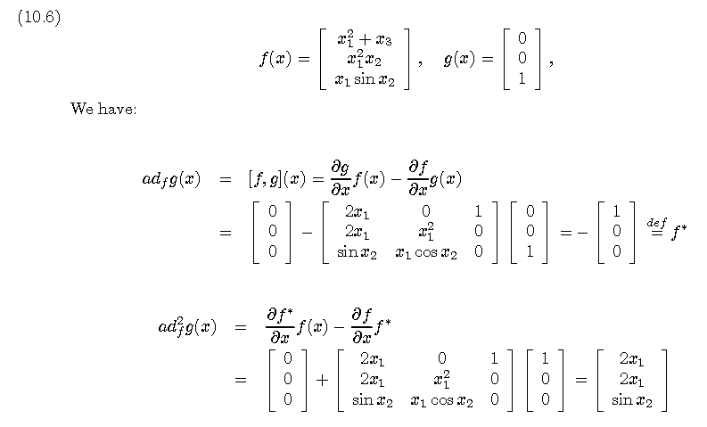

Slide 65
Homework 10.2

Slide 66
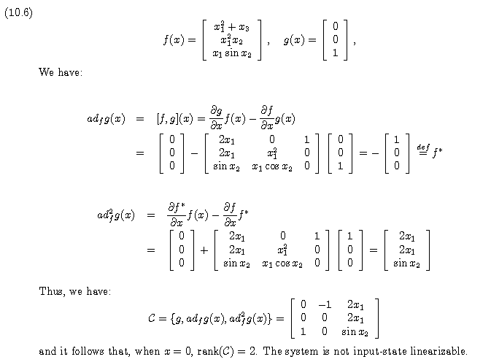

Slide 67
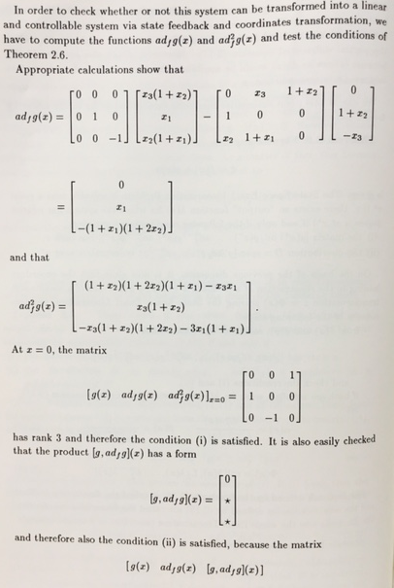

Slide 68
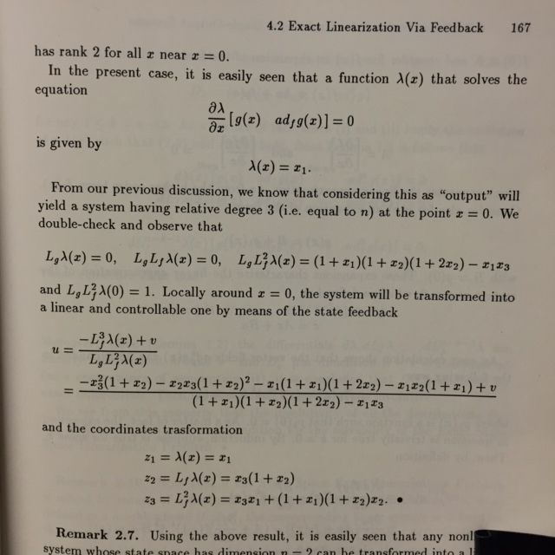

Slide 69
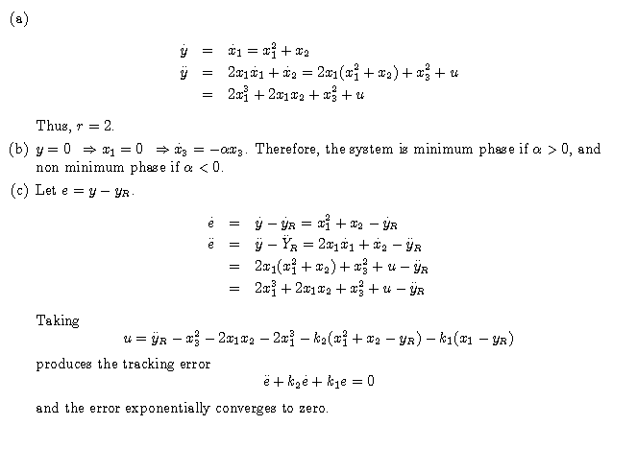

Slide 70
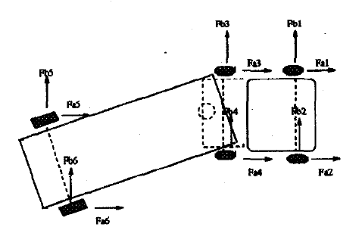
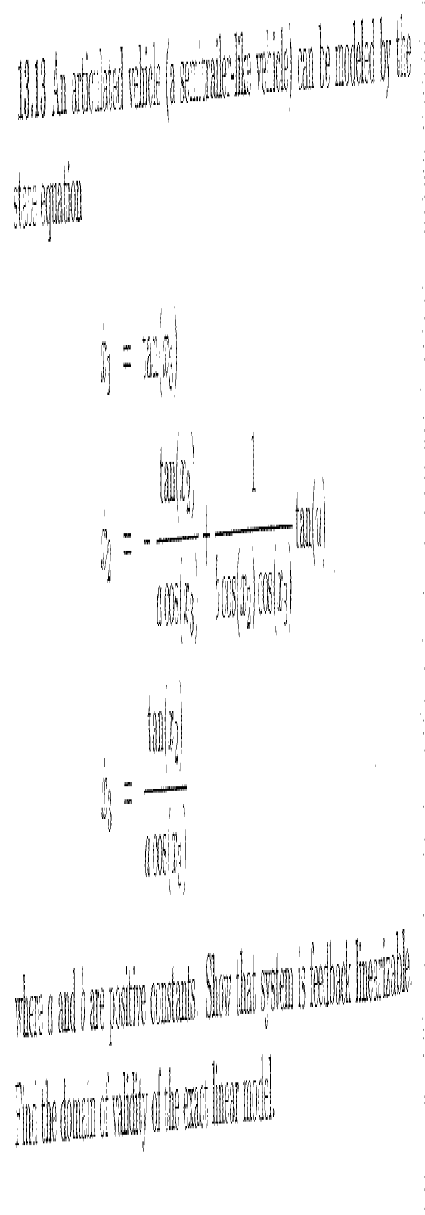
Homework 10.3

Slide 71
Find the transformation for the input-state linearization.

Slide 74
Homework 10.4
Find the transformation for the input-state linearization.
Place the eigenvalues at -1,-2,-3,-4 and simulate

Slide 75
Homework 10.4 (sol)
Arrange in state-space form:

Slide 76
Homework 10.4 (sol)
Find T₁-T₄

Slide 77
Homework 10.4 (sol)

Slide 78
Homework 10.4 (sol)

Slide 79
Homework 10.4 (sol)

Slide 80
Homework 10.4 (sol)
A =
0 1 0 0
0 0 1 0
0 0 0 1
0 0 0 0
B =
0
0
0
1
where

Slide 81
Homework 10.4 (sol)
In MATLAB
>> A=[0 1 0 0;0 0 1 0;0 0 0 1;0 0 0 0]
>> B=[0;0;0;1]
>> P=[-1,-2,-3,-4]
>>G=place(A,B,P)
G =
24.0000 50.0000 35.0000 10.0000

Slide 82
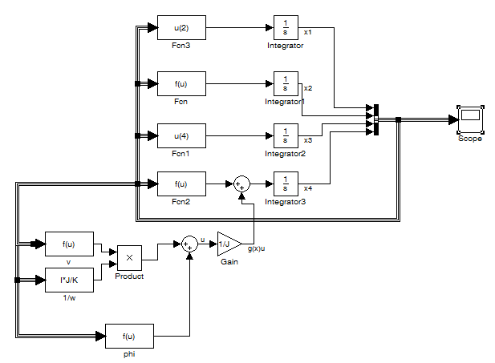
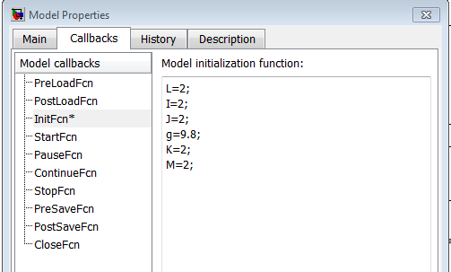
Homework 10.4 (sol)
Expression:
-(M*g*L/I)*sin(u(1))-(K/I)*(u(1)-u(3))
Expression:
(K/J)*(u(1)-u(3))
Expression:
-(24*(u(1))+50*(u(2))+35*(-(M*g*L/I)*sin(u(1))-(K/I)*(u(1)-u(3)))+10*(-(M*g*L/I)*u(2)*cos(u(1))-(K/I)*u(2)+(K/I)*u(4)))
Expression:
(-(I*J/K)*((M*g*L/I)*sin(u(1))*u(2)*u(2)+(-(M*g*L/I)*cos(u(1))-(K/I))*(-(M*g*L/I)*sin(u(1))-(K/I)*(u(1)-u(3)))+(K*K/(J*I))*(u(1)-u(3

Slide 83
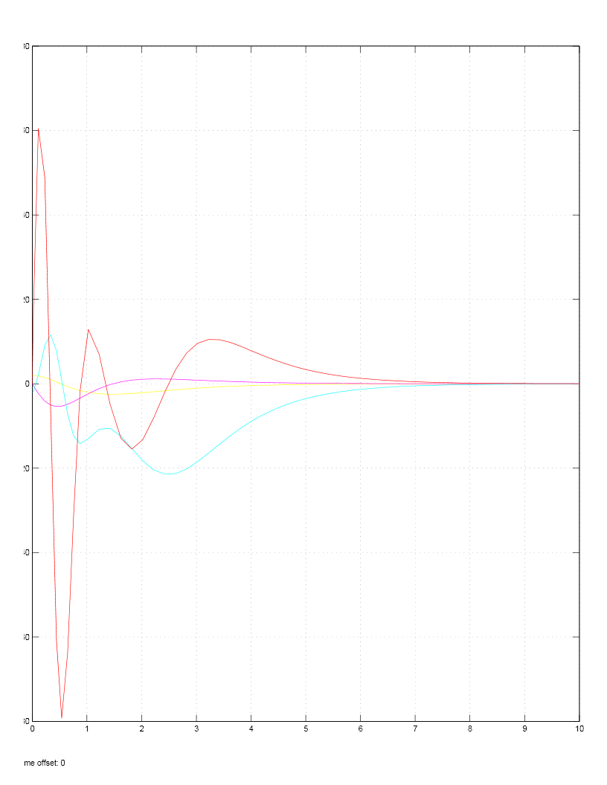
Homework 10.4 (sol)
Response to initial conditions x1=2, x3=-2
Legend:
X1-Yellow
X2-Magenta
X3-Cyan
X4-Red

Slide 84
Homework 10.4

Slide 87
Homework 10.5

Slide 88
Find the transformation for the input-state linearization.

Slide 90
Linearized System for One Link Robot
Contd…

Slide 91
Linearized System for One Link Robot (Contd.)
Contd…

Slide 92
Linearized System for One Link Robot (Contd.)
Contd…

Slide 93
Linearized System for One Link Robot (Contd.)
Contd…

Slide 94
Linearized System for One Link Robot (Contd.)

